Slide 1

A Project Presentation On SQL Injection
THE NATIONAL INSTITUTE OF ENGINEERING, MYSURU
(An Autonomous Institute under VTU, Belagavi)
ESTD : 1946
Under the Guidance of
Ms. M.Prameela
Assistant Professor
Submitted By :-
Shivaganesh Pattankar
Nikhil Nettar
Shrinivas Kulkarni

Slide 2
contents
What is sql?
What can SQL do?
What is sql Injection?
Sql Injection Attacks is on the rise
Abstract
Introduction
System Design and Implementation
Conclusion

Slide 3
What is sql?
SQL stands for structured query language
SQL lets you access and manipulate databases
SQL became a standard of the American National Standards Institute (ANSI) in 1986, and of the International Organization For Standardization (ISO) in 1987

Slide 4
What can SQL do?
SQL can execute queries against a database
SQL can retrieve data from a database
SQL can insert records in a database
SQL can update records in a database
SQL can delete records from a database
SQL can create new databases
SQL can create new tables in a database
SQL can create stored procedures in a database
SQL can create views in a database
SQL can set permissions on tables, procedures, and views

Slide 5
What is sql injection?
SQL injection is a web security vulnerability that allows an attacker to interfere with the queries that an application makes to its database.
It is probably the most dangerous known web attack.
It generally allows an attacker to view data that they are not normally able to retrieve.
This might include data belonging to other users, or any other data that the application itself is able to access.
In many cases, an attacker can modify or delete this data, causing persistent changes to the application's content or behavior.
In some situations, an attacker can escalate an SQL injection attack to compromise the underlying server or other back-end infrastructure, or perform a denial-of-service attack.
By levering SQL Injection, an attacker could bypass authentication access, modify and delete data within a database.

Slide 6
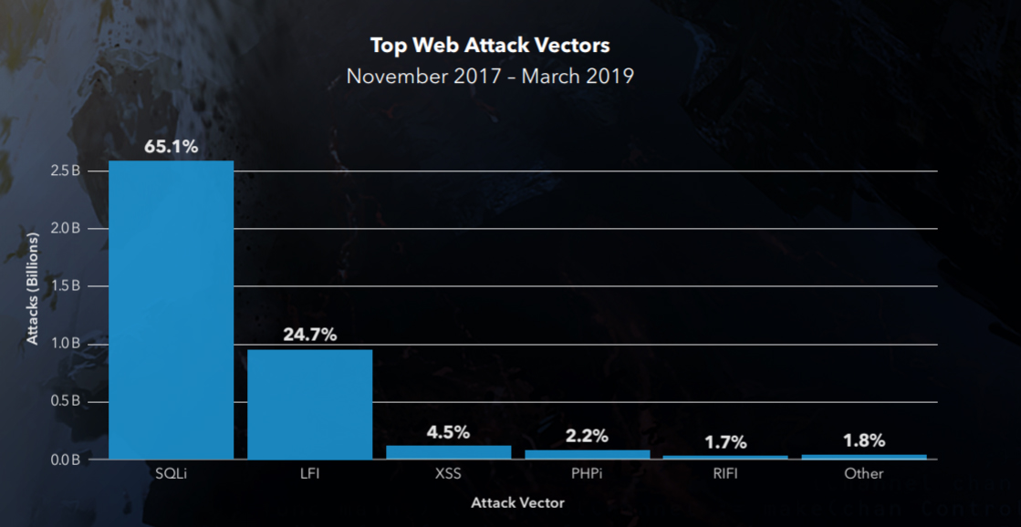
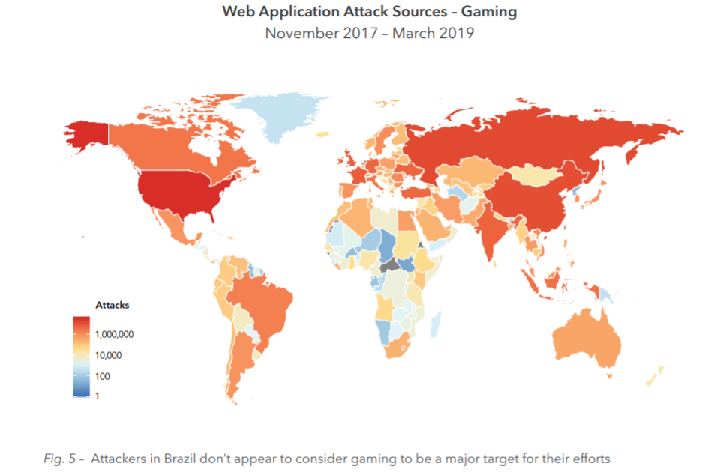
Sql Injection Attacks is on the rise

Slide 7
Impact
The impact SQL injection can have on a business is far-reaching.
A successful attack may result in the unauthorized viewing of user lists, the deletion of entire tables and, in certain cases, the attacker gaining administrative rights to a database, all of which are highly detrimental to a business.
It leads to leakage of sensitive information, decline in reputation, loss of control of database server, data loss, Denial of Service.
Some of the most well-known attacks include:-
On March 29, 2006, a hacker discovered an SQL injection flaw in an official Indian Government's Tourism site.
On March 27, 2011, www.mysql.com, the official homepage for MySQL, was compromised by a hacker using SQL blind injection.
On June 1, 2011, "hacktivists" of the group LulzSec were accused of using SQLI to steal coupons, download keys, and passwords that were stored in plaintext on Sony's website, accessing the personal information of a million users.

Slide 8
Tools we will be using to carry out sql Injection
Burpsuite:-
Burp or Burp Suite is a set of tools used for penetration testing of web applications.
It is developed by the company named Portswigger, which is also the alias of its founder Dafydd Stuttard.
BurpSuite aims to be an all in one set of tools and its capabilities can be enhanced by installing add-ons that are called BApps.
It is the most popular tool among professional web app security researchers and bug bounty hunters.
BurpSuite contains an intercepting proxy that lets the user see and modify the contents of requests and responses while they are in transit.
It also lets the user send the request/response under monitoring to another relevant tool in BurpSuite, removing the burden of copy-paste.
The proxy server can be adjusted to run on a specific loop-back ip and a port. The proxy can also be configured to filter out specific types of request-response pairs.
Sqlmap
Kali Linux

Slide 9
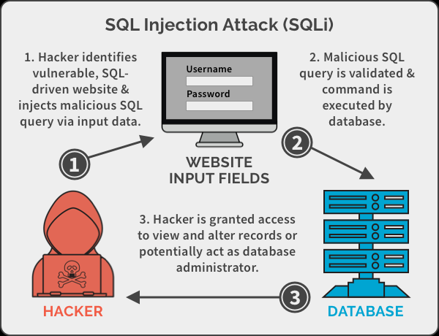
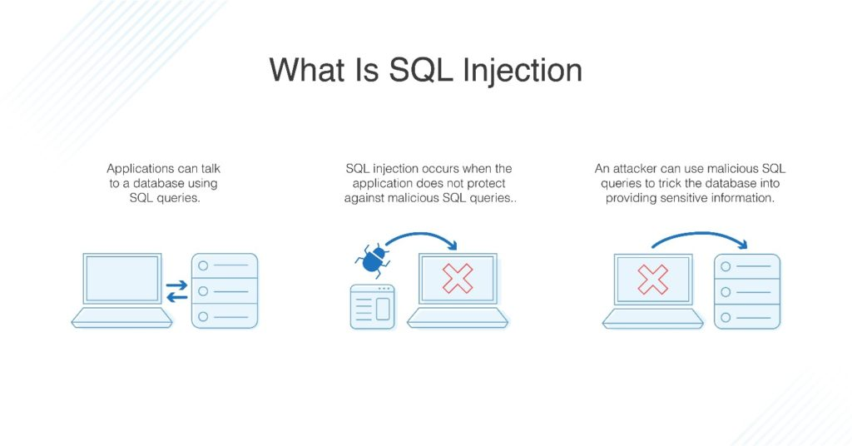
How does SQL Injection work?

Slide 10
What is sqlmap?
sqlmap is an open source penetration testing tool that automates the process of detecting and exploiting SQL injection flaws and taking over of database servers.
It comes with a powerful detection engine, many niche features for the ultimate penetration tester and a broad range of switches lasting from database fingerprinting, over data fetching from the database, to accessing the underlying file system and executing commands on the operating system via out-of-band connections.
Its features include:-
Full support for MySQL, Oracle, PostgreSQL, Microsoft SQL Server, Microsoft Access, IBM DB2, SQLite, database management systems.
Full support for six SQL injection techniques: boolean-based blind, time-based blind, error-based, UNION query-based, stacked queries and out-of-band.
Automatic recognition of password hash formats and support for cracking them using a dictionary-based attack.
Support to dump database tables entirely, a range of entries or specific columns as per user's choice. The user can also choose to dump only a range of characters from each column's entry.
Support to search for specific database names, specific tables across all databases or specific columns across all databases' tables. This is useful, for instance, to identify tables containing custom application credentials where relevant columns' names contain string like name and pass.

Slide 11
Abstract
Web sites are dynamic, static, and most of the time a combination of both. Web sites need protection in their database to assure security. An SQL injection attacks interactive web applications that provide database services.
These applications take user inputs and use them to create an SQL query at run time. In an SQL injection attack, an attacker might insert a malicious SQL query as input to perform an unauthorized database operation.
Using SQL injection attacks, an attacker can retrieve or modify confidential and sensitive information from the database. It may jeopardize the confidentiality and security of Web sites which totally depends on databases.
The main idea here is to demonstrate how SQL Injection can be used to hack into a HTTP target web site and gain unauthorized access to the database and discuss possible solutions to prevent such attacks in the future.

Slide 12
Introduction
In recent years, widespread adoption of the internet has resulted in to rapid advancement in information technologies. The internet is used by the general population for the purposes such as financial transactions, educational endeavors, and countless other activities. The use of the internet for accomplishing important tasks, such as transferring A balance from A bank account, always comes with A security risk. Today’s web sites strive to keep their users’ data confidential and after years of doing secure business online, these companies have become experts in information security. The database systems behind these secure websites store non-critical data along with sensitive information, in A way that allows the information owners quick access while blocking break-in attempts from unauthorized users.
A common break-in strategy is to try to access sensitive information from a database by first generating a query that will cause the database parser to malfunction, followed by applying this query to the desired database. Such an approach to gaining access to private information is called SQL injection. Since databases are everywhere and are accessible from the internet, dealing with SQL injection has become more important than ever. Although current database systems have little vulnerability, the computer security institute discovered that every year about 50% of databases experience at least one security breach. The loss of revenue associated with such breaches has been estimated to be over four million dollars.
Hence, there is an urgent need to understand the attack and come up with possible solutions to prevent future attacks.

Slide 13
Existing system
The existing system lacks a security mechanism to prevent SQL Injection attacks which leads to hackers getting unauthorized access to the database system. Once an entry point is established, a hacker’s actions will only be limited by the security of the user they are operating as. Some examples of unauthorized use include:
Modifying TSQL statements to return additional data
Modify stored procedures, functions, or other database schemas
Test for the existence of database or server objects, such as tables or users
Alter passwords or permissions
Access components outside of SQL Server, such as server or storage infrastructure
Delete, steal, alter, encrypt, or attempt to ransom data from within the database
Perform a denial-of-service attack on the database server by utilizing excessive resources
A sneaky hacker will do this to a different server or service to introduce a distraction

Slide 14
Proposed system
With an understanding of what SQL injection is and its causes, we can begin to formulate strategies to detect and prevent it. This is our ultimate goal and one that is critical to data security and is one that affects any platform where data is stored, whether in SQL Server, MySQL, NoSQL, or some other.
The only sure way to prevent SQL Injection attacks is input validation and parametrized queries including prepared statements. The application code should never use the input directly. The developer must sanitize all input, not only web form inputs such as login forms. They must remove potential malicious code elements such as single quotes. It is also a good idea to turn off the visibility of database errors on your production sites. Database errors can be used with SQL Injection to gain information about your database.
If you discover an SQL Injection vulnerability, for example using an Acunetix scan, you may be unable to fix it immediately. For example, the vulnerability may be in open source code. In such cases, you can use a web application firewall to sanitize your input temporarily.
The best way to prevent SQL Injections is to use safe programming functions that make SQL Injections impossible: parameterized queries (prepared statements) and stored procedures. Every major programming language currently has such safe functions and every developer should only use such safe functions to work with the database

Slide 15
System Design
Kali Linux Setup
Download and Install the Virtual Box
Step 1 − To download, go to https://www.virtualbox.org/wiki/Downloads. Depending on your operating system, select the right package. In this case, it will be the first one for Windows as shown in the following screenshot.
Step 2 − Click Next.
Step 3 − The next page will give you options to choose the location where you want to install the application. In this case, let us leave it as default and click Next.
Step 4 − Click Next and the following Custom Setup screenshot pops up. Select the features you want to be installed and click Next.
Step 5 − Click Yes to proceed with the installation.
Step 6 − The Ready to Install screen pops up. Click Install.
Step 7 − Click the Finish button.

Slide 16
Install Kali Linux
Step 1 − Download the Kali Linux package from its official website: https://www.kali.org/downloads/
Step 2 − Click VirtualBox → New as shown in the following screenshot.
Step 3 − Choose the right virtual hard disk file and click Open.
Step 4 − The following screenshot pops up. Click the Create button.
Step 5 − Start Kali OS. The default username is root and the password is toor.
SQL map Installation
SQLMAP comes pre – installed with kali Linux, which is the preferred choice of most penetration testers. However, you can install sqlmap on other Debian based Linux systems using the command
sudo apt-get install sqlmap

Slide 17
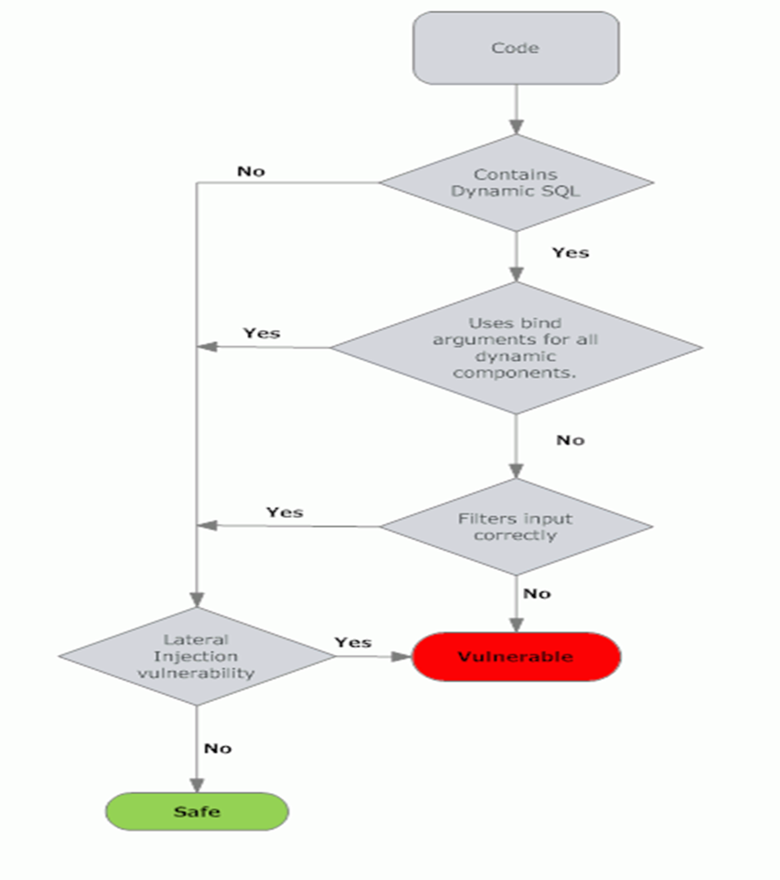
Vulnerability Assessment Flowchart

Slide 18
System Implementation
sqlmap -u http://testphp.vulnweb.com/listproducts.php?cat=1 --dbs
Here we will demonstrate a SQL Injection attack on the vulnerable target site “http://testphp.vulnweb.com/artists.php?artist=1”
First, ensure that Burp is correctly configured with your browser. Ensure "Intercept is off" in the Proxy "Intercept" tab.
Visit the web page of the application that you are testing. Return to Burp and ensure "Intercept is on" in the Proxy "Intercept" tab. Now send a request to the server. In this example by clicking the "Submit" button.
The request will be captured in the Proxy "Intercept" tab. Now save this request in a text file and name it as “ log.req”.
Now, we have to enter the text file named “log.req” along with the -r parameter. Now typically, we would want to test whether it is possible to gain access to a database. So we use the –dbs option to do so. –dbs lists all the available databases.
Therefore enter the command “sqlmap -r log.req --dbs “
We observe that their are two databases, acuart and information_schema

Slide 19
dump
To try and access any of the databases, we have to slightly modify our command. We now use -D to specify the name of the database that we wish to access, and once we have access to the database, we would want to see whether we can access the tables. For this, we use the –tables query. Let us access the acuart database.
Use the command “sqlmap -r log.req -D acuart –tables”
We see that 8 tables have been retrieved. So now we definitely know that the website is vulnerable.
If we want to view the columns of a particular table, we can use the following command, in which we use -T to specify the table name, and –columns to query the column names. We will try to access the table ‘artists’.
Use the command “sqlmap -r log.req -D acuart -T artists --columns “
Similarly, we can access the information in a specific column by using the following command, where -C can be used to specify multiple column name separated by a comma, and the –dump query retrieves the data.
Use the command “sqlmap -r log.req -D acuart -T artists -C aname --dump “
We can see that we have accessed the data from the database. Similarly, we keep extracting relevant information using the appropriate sqlmap commands until we get the password and username into the database, using which we can enter the website unknown to the admin and alter the details inside the target side.

Slide 20
Use the command “sqlmap -r log.req -D acuart -T users -C uname –dump
Here, we can access the username information.
Use the command “sqlmap -r log.req -D acuart -T users -C pass --dump
Here, we can access the password information
Now use the gained credentials to login to website and access the user information

Slide 21
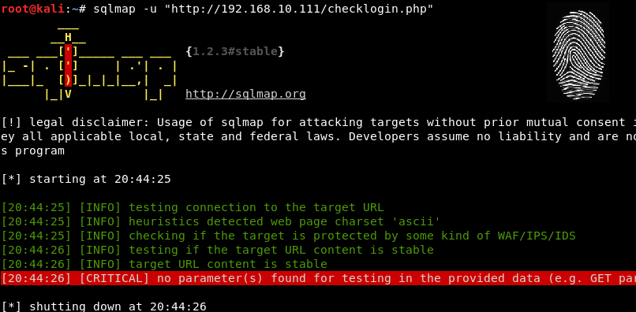
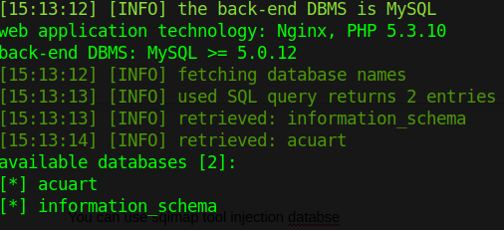
Snapshots

Slide 22
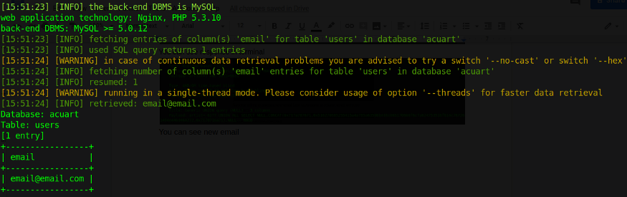
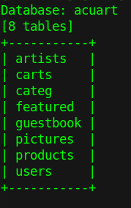
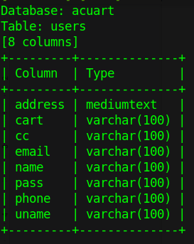
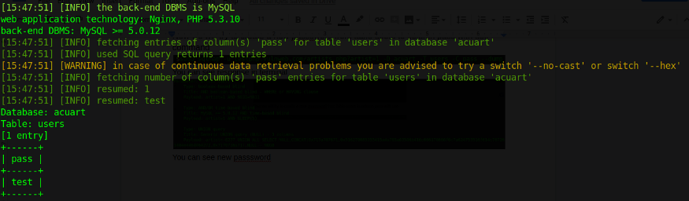
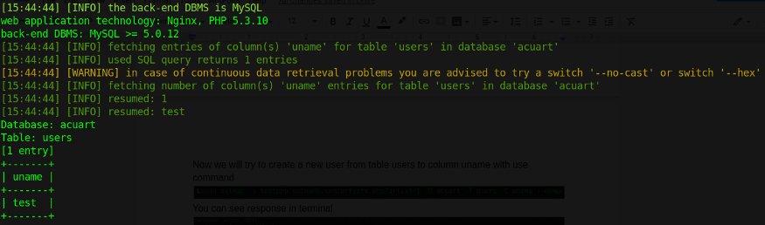

Slide 23
Ways to prevent SQL Injection
The following suggestions can help prevent an SQL injection attack from succeeding:
1. Don’t use dynamic SQL:- Avoid placing user-provided input directly into SQL statements.
Prefer prepared statements and parameterized queries, which are much safer.
Stored procedures are also usually safer than dynamic SQL.
2. Sanitize user-provided inputs:- Properly escape those characters which should be escaped.
Verify that the type of data submitted matches the type expected.
3. Don’t leave sensitive data in plaintext:- Encrypt private/confidential data being stored in the database.
Salt the encrypted hashes. This also provides another level of protection just in case an attacker successfully exfiltrates sensitive data.

Slide 24
4. Limit database permissions and privileges:- Set the capabilities of the database user to the bare minimum required. This will limit what an attacker can do if they manage to gain access.
5. Avoid displaying database errors directly to the user:- Attackers can use these error messages to gain information about the database.
6. Use a Web Application Firewall (WAF) for web applications that access databases:- This provides protection to web-facing applications.It can help identify SQL injection attempts. Based on the setup, it can also help prevent SQL injection attempts from reaching the application (and, therefore, the database).

Slide 25
Conclusion
Most of the web applications uses intermediate layer to accept a request from the user and retrieve sensitive information from the database.
Most of the time they use scripting language to build intermediate layer.
To breach security of database hacker often uses SQL injection techniques. Generally attacker tries to confuse the intermediate layer technology by reshaping the SQL queries.
Perhaps, attacker will change the activities of the programmer for their benefits. A number of methods are used to avoid SQL injection attack at application level, but no feasible solution is available yet.
To conclude the automated technique for preventing, detecting and logging the SQL injection attack in ‘stored procedure' is commonly used and they are concrete method. In the future, a more reliable, secure and impregnable website can be designed using the methods discussed above.

